Slide 1
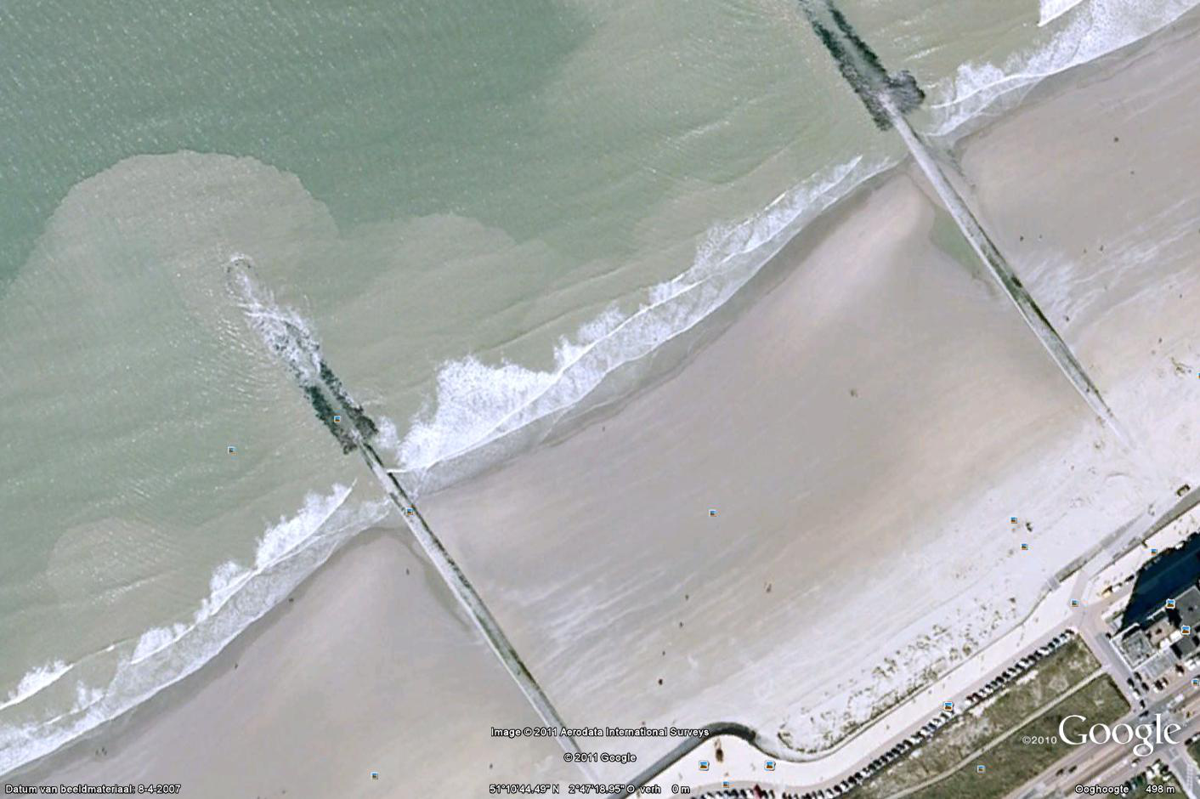
VRIJDAG
DOUBLE
OCEANMAN

Slide 2
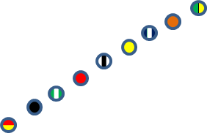
ZATERDAG
BOARD
SKI
RESCUEBOARD
RESCUE
FLAGS
BEACH RUN

Slide 3
ZONDAG
OCEANMAN
SURF RACE
RESCUE TUBE RESCUE
SPRINT
4x90

Slide 4
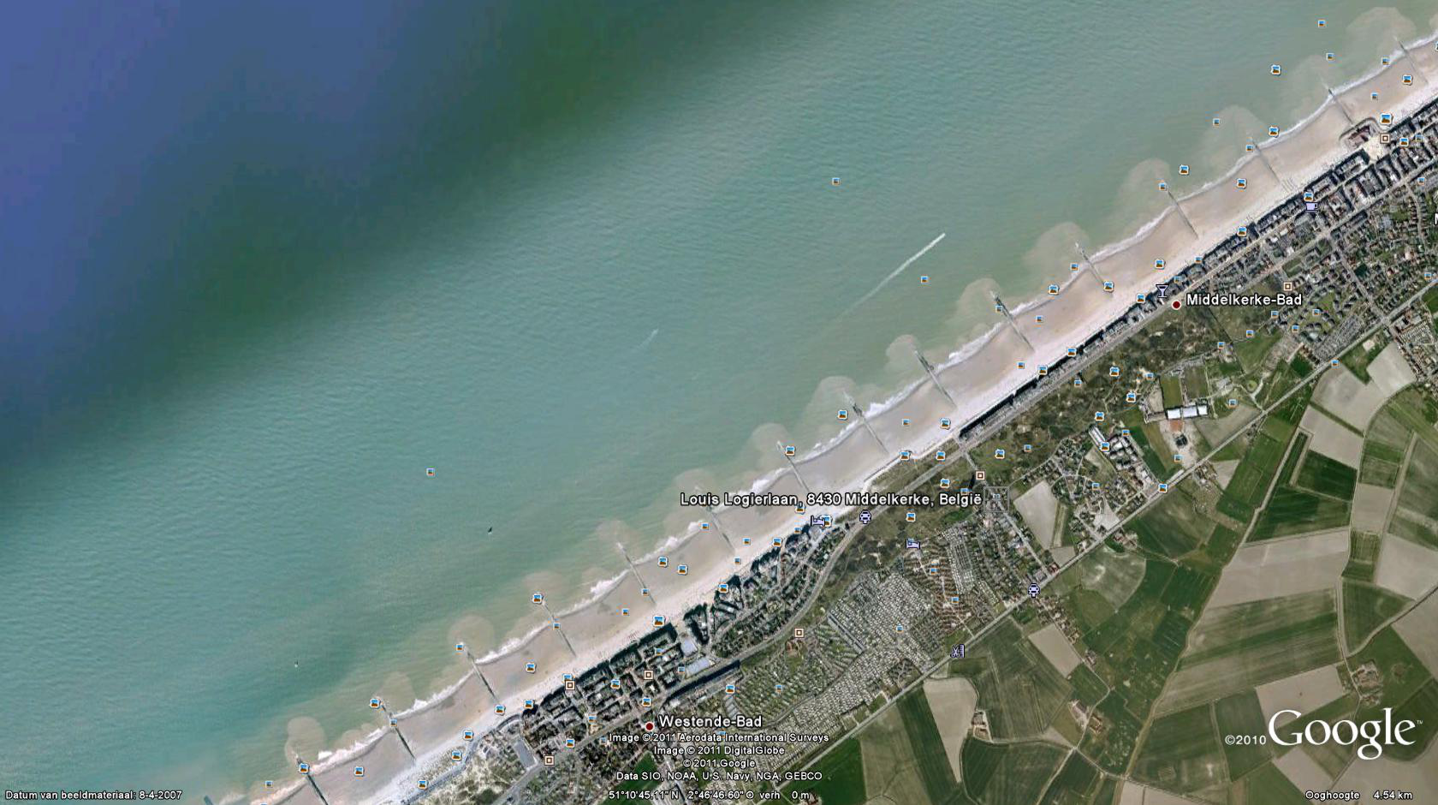
MAANDAG
SURF SKI
SWIM
BOARD
RUNNING

